Slide 1
Medium Fidelity

Slide 2
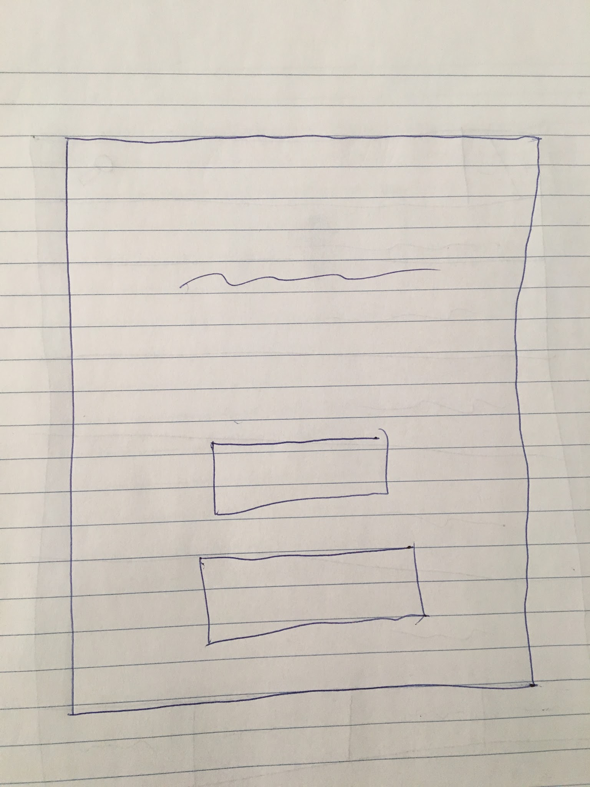
Login Screen
App Name
User ID
Password

Slide 3
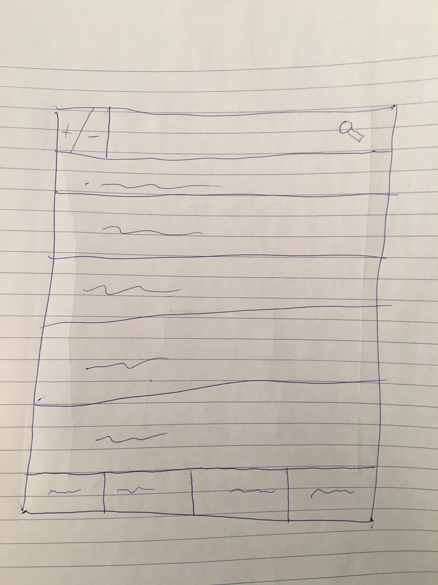
Main Menu
Add/delete entry
Search bar
List of inventory items
(will show blank at startup)
Buttons leading user elsewhere
(Main, Vendor, Contact, Settings)

Slide 4
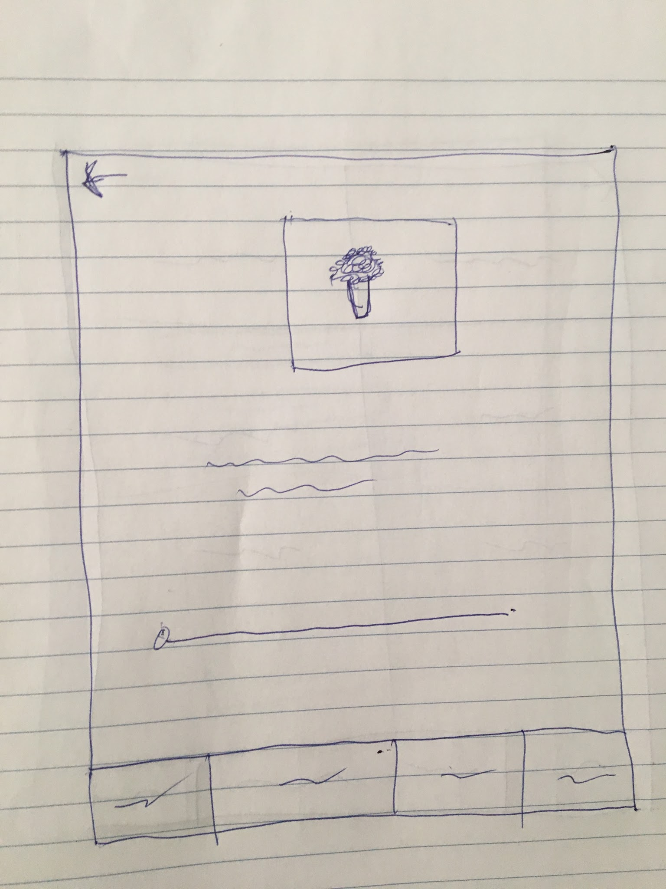
Inventory screen (one item)
Goes back to previous screen
Image of what user clicked
What it is along with which vendor sells and what dishes contain it
Adjust bar of amount of inventory

Slide 5
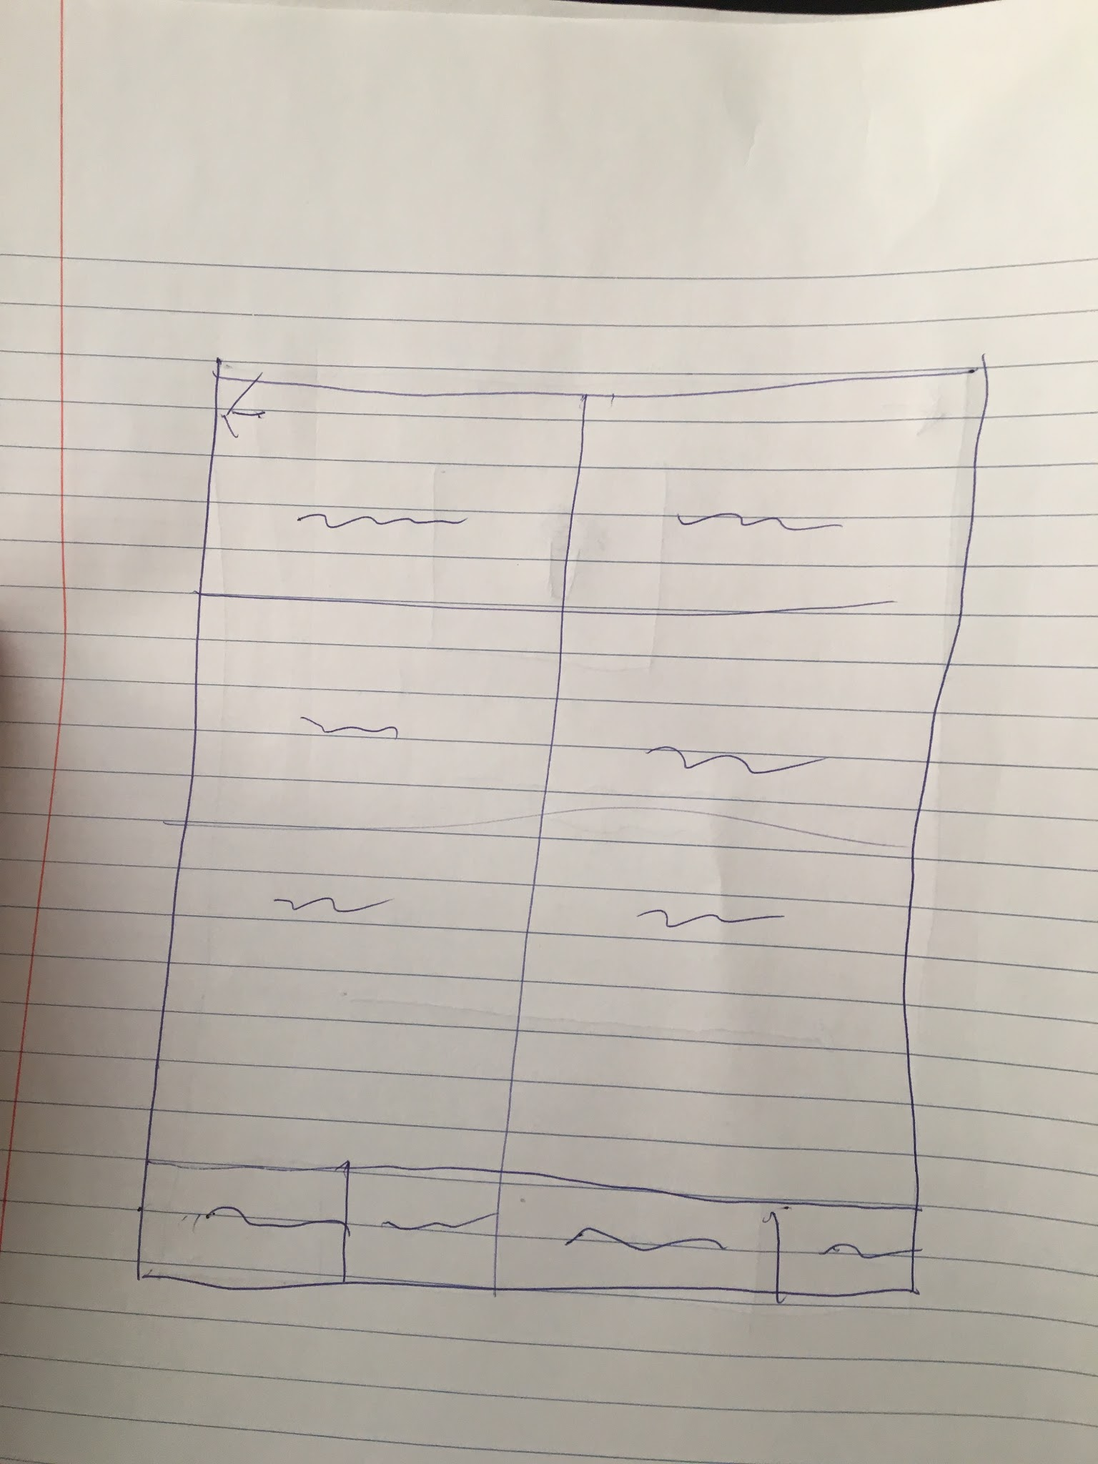
Vendor screen
Shows vendor name
Contact of vendor along with next schedule of shipment

Slide 6
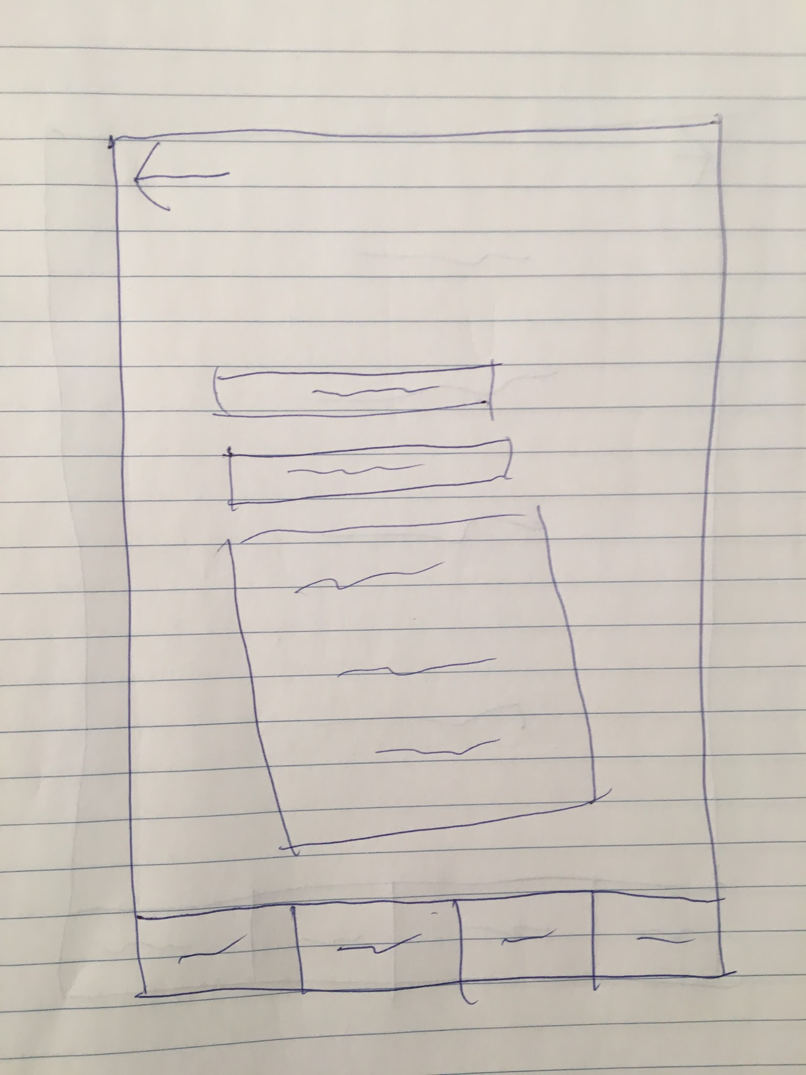
Contact
User email
Subject
Text box

Slide 7
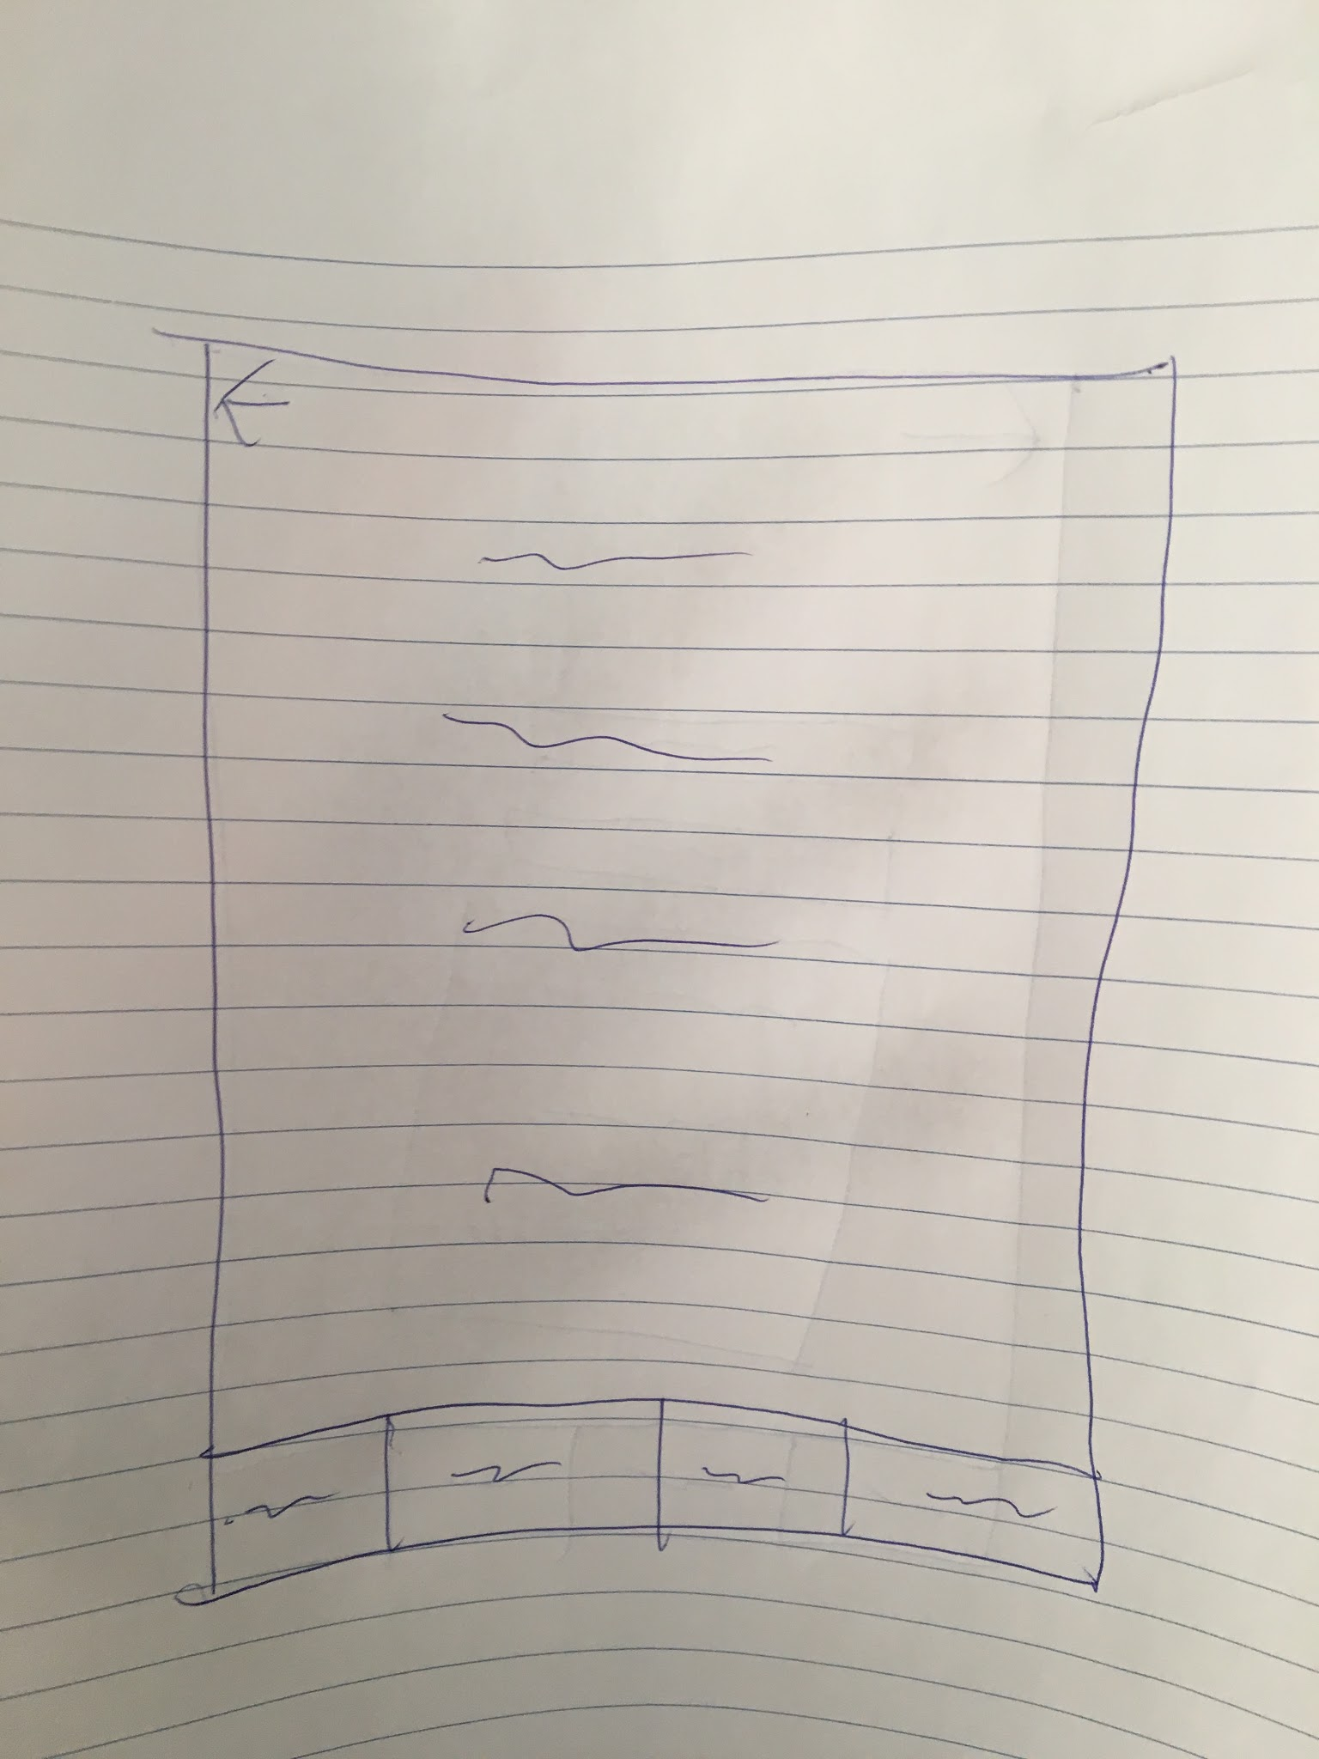
Settings
Shows user info and company info (managers will be given options to adjust other user privileges

